Slide 1

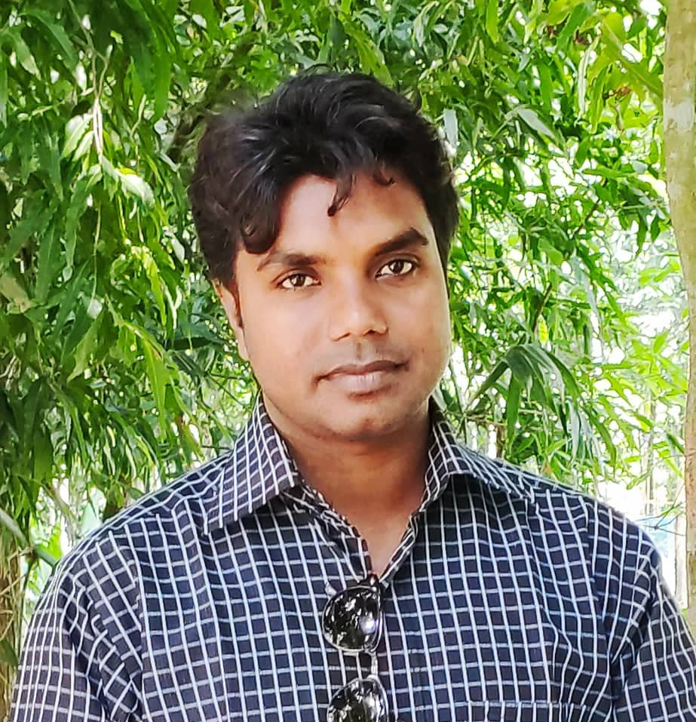





My name is IMRAN HOSSAIN, one of the District Ambassador of the beloved platform named 1 HOUR STUDY.
I am from MANINRAMPUR, JASHORE because WEB DESIGNING & DEVELOPMENT is my passion
and this is the place to find an inspirational, innovative and soothing my sublime mind.
I have a rich background in Soft-Skill for messaging, optimization and would love to tell you about the strengths
I can bring to this role.
KHULNA AMBASSADOR ZONE

Slide 2
TOPIC
Best utilization of SOCIAL MEDIA: Facebook
KHULNA AMBASSADOR ZONE

Slide 3
Social media is a computer-based technology
that facilitates the sharing of ideas, thoughts,
and information through the building of virtual
networks and communities. By design, social
media is Internet-based and gives users quick
electronic communication of content.
Content includes personal information, documents,
videos, and photos. Users engage with social media
via a computer, tablet, or smartphone via web-based
software or applications.
What is
Social
Platform?
KHULNA AMBASSADOR ZONE

Slide 4
1. Instagram -1 billion MAUs
2. YouTube - 1.9 billion MAUs
3. Facebook - 2.23 billion MAUs
4. Twitter -335 million MAUs
5. TikTok -500 million MAUs
6. Pinterest -250 million MAUs
7. Snapchat - 255 million MAUs
7 Top
Social
Platforms
in 2020
KHULNA AMBASSADOR ZONE

Slide 5
Facebook is an American online social media and social networking service owned by Facebook, Inc.
Founder : Mark Zuckerberg
Year : 2004
2006–2012: Public access, Microsoft alliance, and rapid growth
2012–2013: IPO, lawsuits, and one-billionth user
FACEBOOK
Social
Platform!
KHULNA AMBASSADOR ZONE

Slide 6







Facebook
reaction buttons
KHULNA AMBASSADOR ZONE

Slide 7
Facebook
Comment box
KHULNA AMBASSADOR ZONE

Slide 8
Reaction is a quick emotional activity of an users. It keeps a slight impression to the author of the post. S/he may receives it as usual any other reactions.
So, it may not deserve extra attention
Facebook
Comment
vs
Reaction
Where as, Comment is a longer lasting psychological activity of an users. It keeps a special impression to the author of the post. S/he may receives it as an special place of thinking about him/her.
So, it may deserve extra/special attention.
As a result it is often asked to have a pertinent comment if you have time in your hand. You may also use reactions button according to your comments. It’s one of the cunning and astute way of developing social relation between two parties.
KHULNA AMBASSADOR ZONE

Slide 9
There are thousand types of comment in Facebook. Al of the comments don’t draw the attention. We often find three types of Comments among the buckets of comment.
Facebook
Comment
Style
01. Birthday Comment
02. Gratitude Comment
03. Stalker Comment
KHULNA AMBASSADOR ZONE

Slide 10
Friend’s Birthday Wishing Text
1
I feel so lucky to have you as my friend. Hope your birthday is as special as you are. May, all of your dreams come true. Thanks for being such a great friend. Happy birthday! And I want to wish you all the love and happiness in the world, all of which you deserve. Again, Happy birthday my friend!
Facebook
Comment
(Birthday)
2
Happy birthday to my best friend, the one who laughs at my silly jokes and still stands beside me even when I do dumb and stupid things! I want to wish you all the love and happiness in the world, all of which you deserve. Again, Happy birthday my friend!
KHULNA AMBASSADOR ZONE

Slide 11
Elder-Person’s Birthday Wishing Text
1
Another year has gone by and never before have you looked so good. Time has been kind to you, and I hope life will always treat you the wonderful way you deserve.
Have a very happy birthday! Laugh a lot and celebrate this special day with the people you love the most.
I wish you the best, and may the next year of your life be the happiest so far.
Lots of love, hugs and best wishes to you!
Facebook
Comment
(Birthday)
2
Today is no ordinary birthday, as the birthday boy is turning 16!
I’m wishing you all the best on this marvelous milestone, and I hope that your special day is full of wonderful moments that leave you with many good memories of your 16th birthday.
KHULNA AMBASSADOR ZONE

Slide 12
Teacher’s Birthday Wishing Text
1
A great teacher is one who knows their students, motivates them, and helps them evolve. You are definitely one of the greatest. Thank you for all your guidance and all you have taught me.
You are a teacher who cares with the kindest heart and the most beautiful soul, and I feel very grateful and fortunate to say that I have been a student of yours!
I wish you a happy birthday and many more to come!
Facebook
Comment
(Birthday)
2
Wishing a happy and blessed birthday to my favorite teacher of all time! I’m very fortunate to have found such a wonderful mentor in you!
To a true blessing of a teacher, I am wishing you a wonderful birthday today!
KHULNA AMBASSADOR ZONE

Slide 13
Success Wishing Text
1
Heartiest congratulations. You deserve the grandest celebration of all. You deserve every bit of it. Your hard work paid off finally. We are so proud of you.
Congrats is a small word, but we are too excited to see you this happy. Be blessed, forever!
My best wishes are always with you and for your future life. many Congratulations to you my dear!
Facebook
Comment
(Success)
KHULNA AMBASSADOR ZONE

Slide 14
Success Wishing Text
1
I feel so overwhelmed by the joy of seeing you win the award. You made us all proud with this win. Congratulations!
I’m so happy that your talent and hard work had finally been rewarded. You really deserved this award more than anyone else!
You didn’t just take the award home with you. You have won the hearts of us with it. Congratulations to you for winning everything!
Facebook
Comment
(Award)
KHULNA AMBASSADOR ZONE

Slide 15
New Couple Wishing Text
Facebook
Comment
(Marriage)
1
I am delighted and overwhelmed to know that you have turned single to mingle. Congratulations, dear! Your really deserved such a cute and lovely life-partner.
I wish you a very happy and peaceful conjugal life. Regard my congratulations text to your life partner. Again wish you a long conjugal life.
KHULNA AMBASSADOR ZONE

Slide 16
Wedding Anniversary Wishing Text
Facebook
Comment
(Wedding)
1
May this day bring countless joy to your life. May the coming years of your life be spent in loving and caring for each other. Happy anniversary!
I wish both of you a thousand years of happy married life. May the joy of this day stay with forever and until the last breath. Again, Happy wedding anniversary!
KHULNA AMBASSADOR ZONE

Slide 17
People with a lot of Facebook friends tend to have low self-esteem.
Extroverts upload photos and update their status more often than introverts.
Conscientious people organize their photos carefully.
Open people are likely to fill out their personal profiles most thoroughly.
Narcissists are most likely to make deeper self-disclosures that contain self-promotional content.
Neurotic people post mostly photos.
Agreeable people are tagged in other people’s photos most often.
Facebook
Reveal
(Personality
&
Self-Esteem)
KHULNA AMBASSADOR ZONE

Slide 18
Thank You
Thank you all for staying with me. Hoping we all together have enjoyed the session.
If I could make it enjoyable to you rather waste your valuable time, I am really sorry for my inability.
Then I can make a full-swing promise that I will make my next presentation more lucrative, educative and enjoyable.
May I wish that you all keep me in your prayer for my well being.
I also make my prayer for your well being during this Corona Pandemic.
And I request to you all to have a vigilance for our family and our beloved family member and our near and dear one.
KHULNA AMBASSADOR ZONE

